Slide 1

Cancer Data Analytics Project Tumor Stage and Grade Analysis

Slide 2
Task/Heading
Stage Distribution by Site
Grade Trends Over Time
Correlate Grade/Stage with Outcome
Stage–Grade Cross-Tab
Objective:
This study aims to analyze tumor stage and grade distributions, identify trends over time, and explore correlations with patient outcomes.
By leveraging data-driven insights, we seek to improve early diagnosis, enhance treatment strategies, and support clinical decision-making.

Slide 3
Stage Distribution by Site
This analysis identifies how tumor stages (T1–T4) are distributed across different sites. Understanding these patterns helps pinpoint high-risk areas, enabling better resource allocation and targeted interventions.
As an oncologist, I want to see how tumor stages (T1, T2, T3, T4) appear across different sites, so I can identify patterns of disease severity.

Slide 4
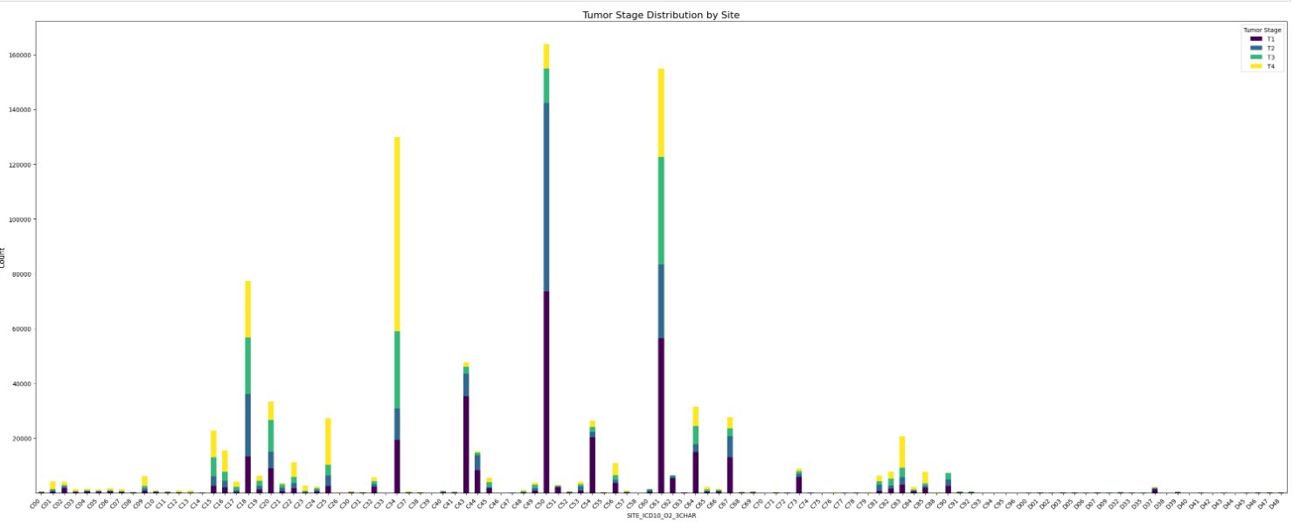

Slide 5
Grade Trends Over Time
Examining grade trends over time reveals changes in tumor aggressiveness or early detection success. These insights guide future research and help focus efforts on emerging challenges in cancer care.
As a researcher, I want to see tumor grade trends by diagnosis date to check if certain grades are more or less common now.

Slide 6
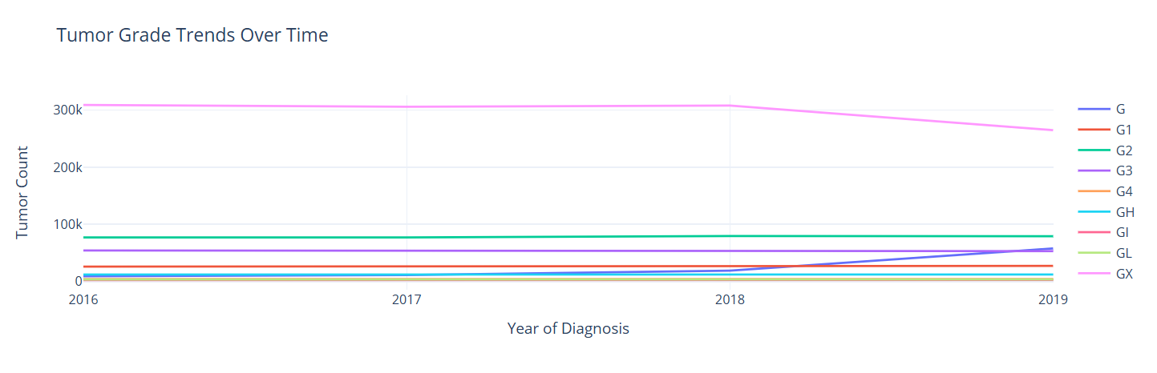
Click the image if you want to view per Tumor Grade

Slide 7

Correlate Grade/Stage with Outcome
As an analyst, I want to see if stage or grade relates to survival or success (from patient or outcome data), so I can pinpoint high-risk groups.
By analyzing survival rates across stages and grades, we can identify high-risk groups with lower survival probabilities. This emphasizes the importance of early diagnosis and targeted treatment strategies.

Slide 8
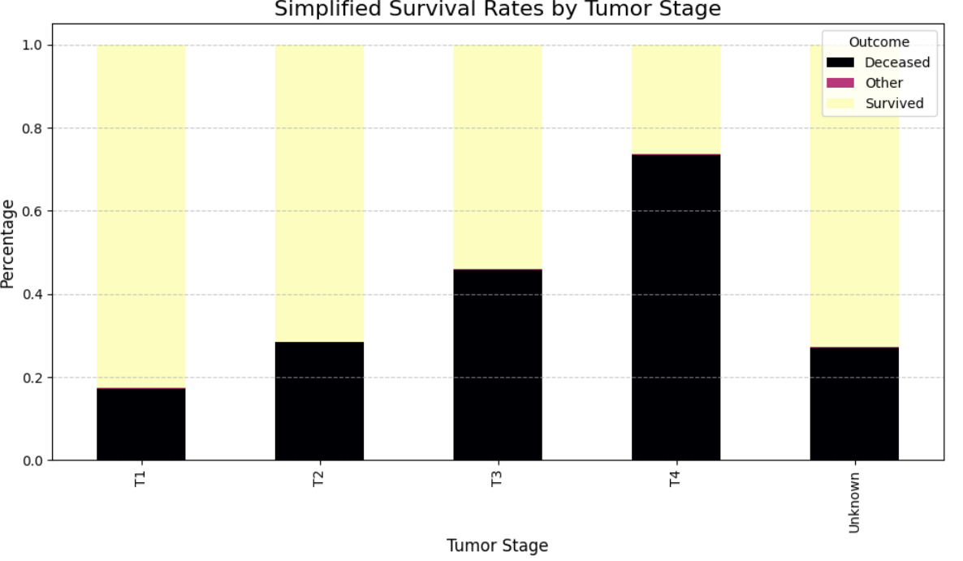

Slide 9
Stage–Grade Cross-Tab
As a clinician, I want a quick cross-tab showing how often each tumor grade (G1, G2, G3) aligns with each stage (T1, T2, etc.).
A quick cross-tab shows the frequency of tumor grades (G1–G3) within each stage (T1–T4). This simplifies data for clinicians, highlighting grade and stage patterns critical for treatment planning.

Slide 10
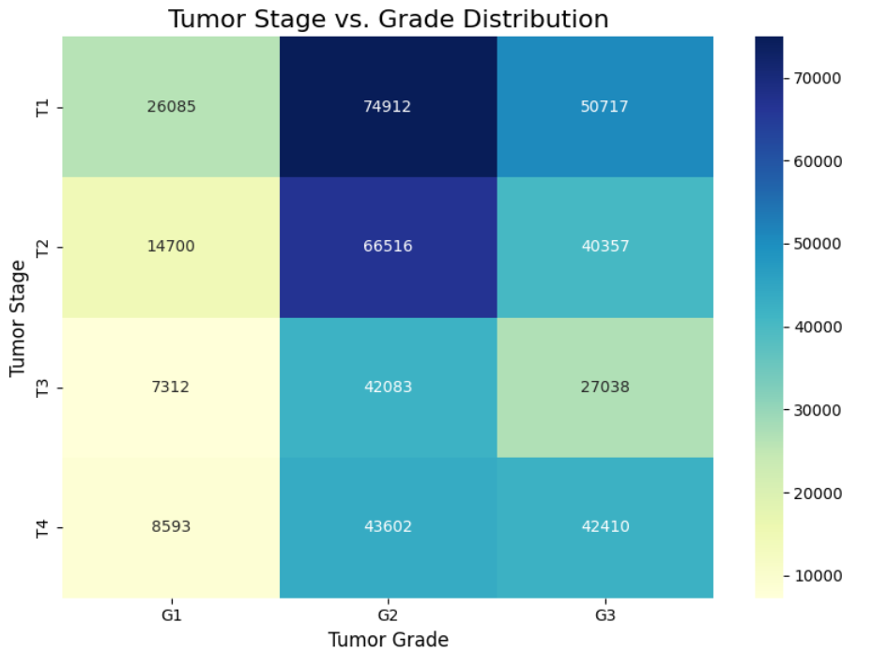

Slide 11
Conclusion
The analysis revealed key insights into tumor distribution, progression trends, and survival outcomes.
Higher stages (T3, T4) are linked to lower survival rates, emphasizing the importance of early detection.
The stage-grade relationship provides valuable guidance for clinicians in risk assessment and treatment planning.
These findings contribute to improved patient care and future research directions in oncology.

Slide 12

Thank you

